Slide 1









Topic
Team Members
Yuyang Rong
Anqi Pang
Jianxiong Cai
Jingyi Huang
Ziyue Li

Slide 2

ONE
Crop Body

Slide 3
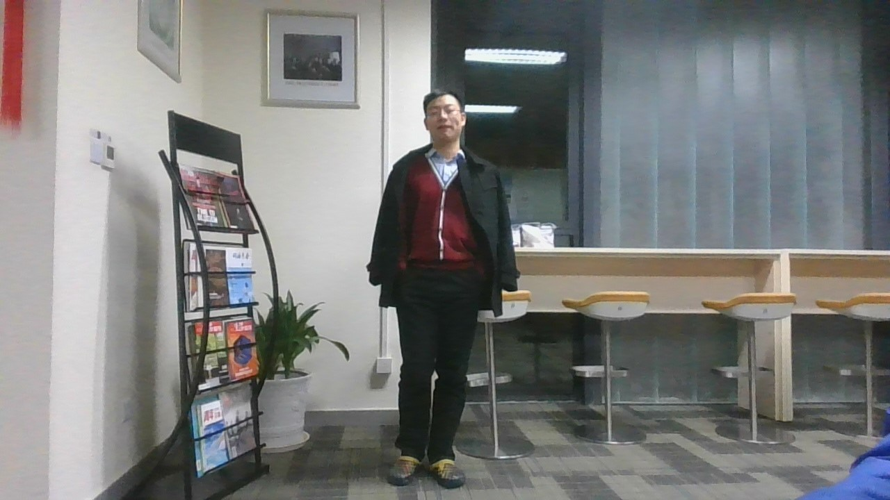
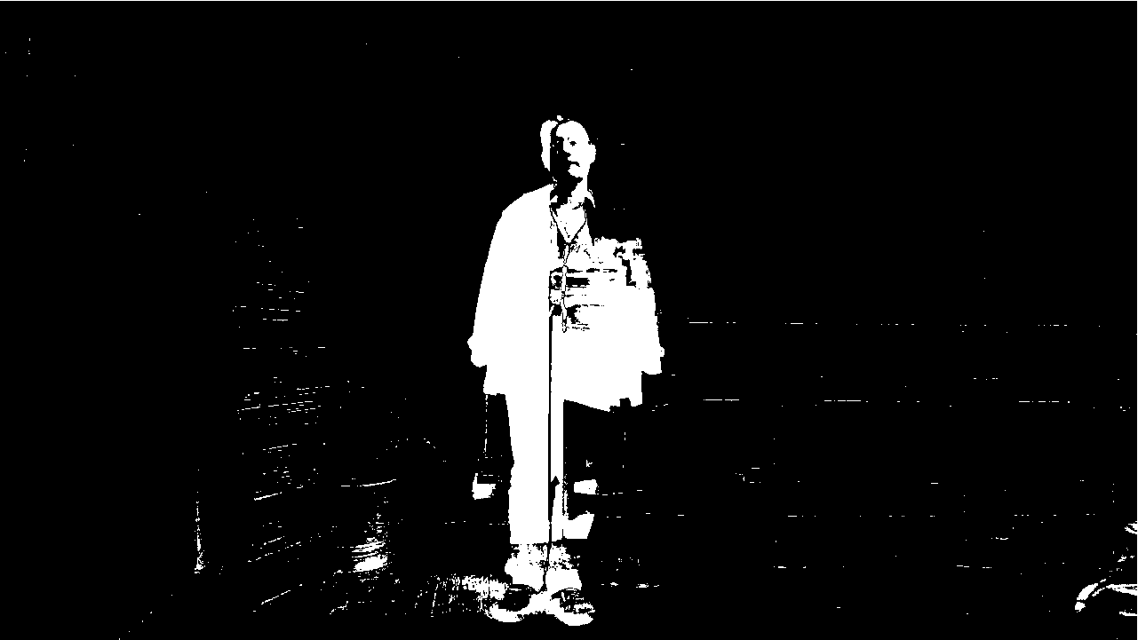
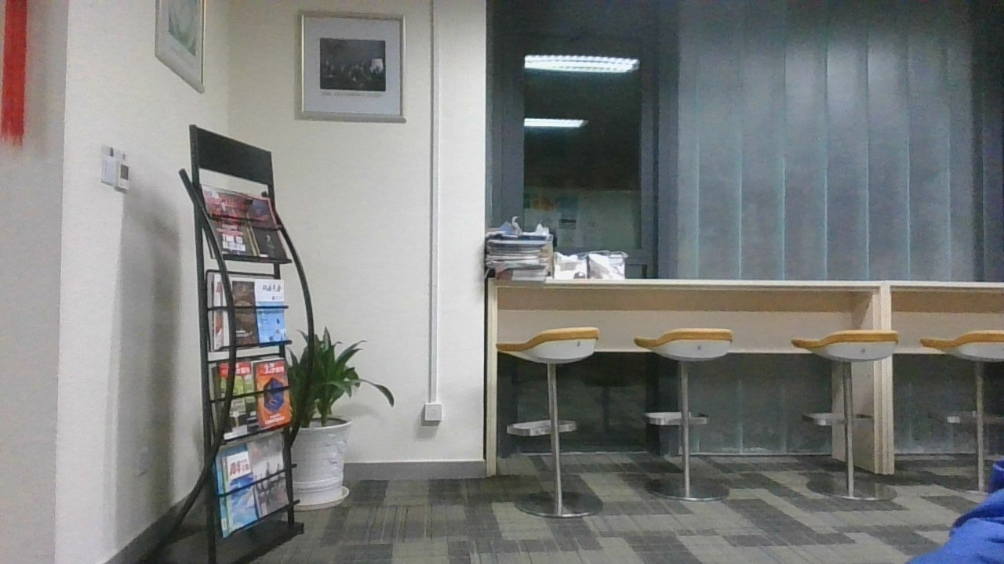
Naive Subtraction

Slide 4
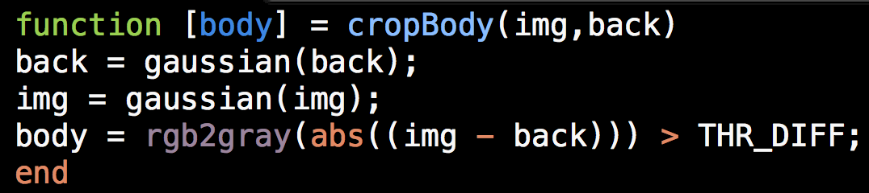
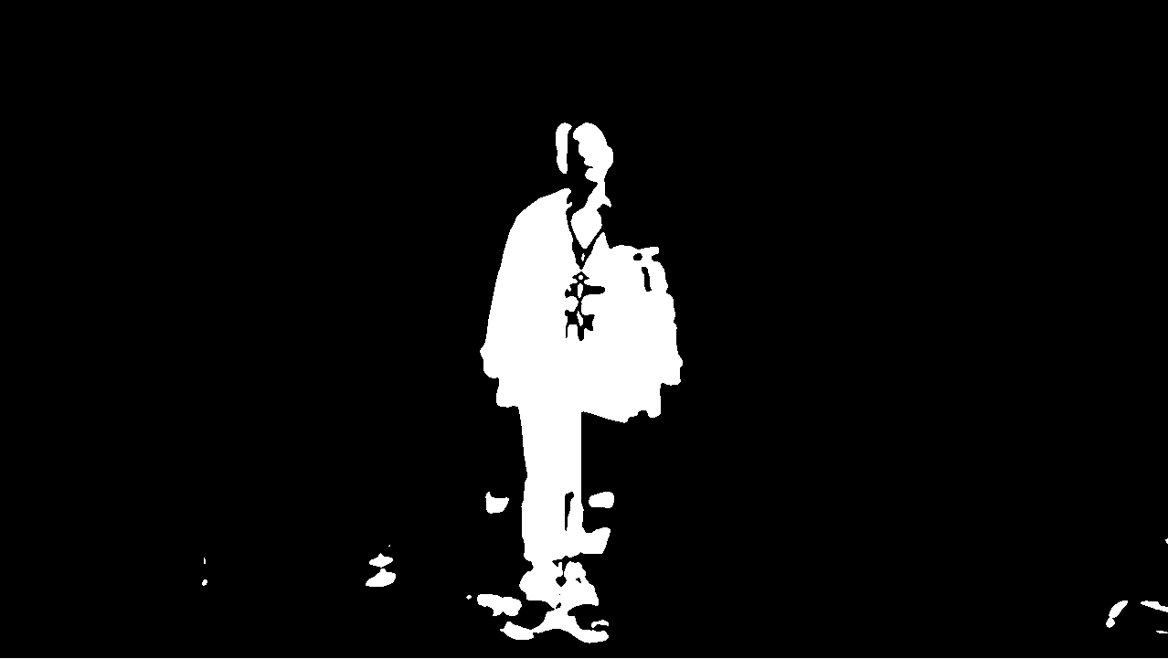
Edge Elimination (Gaussian)

Slide 5
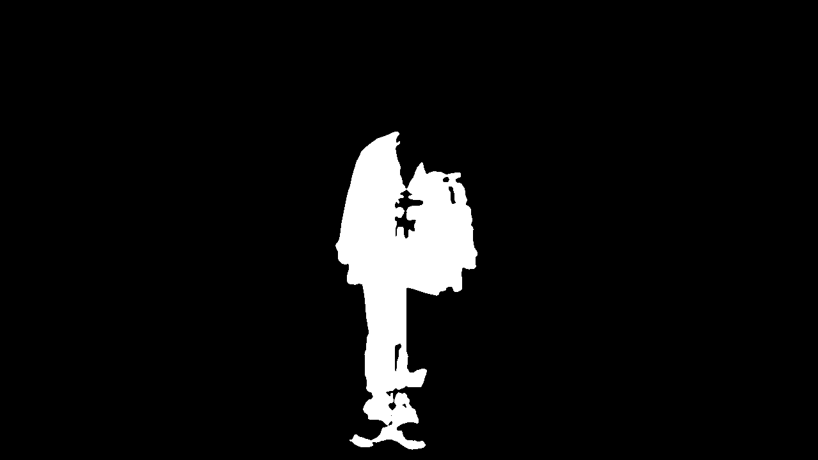
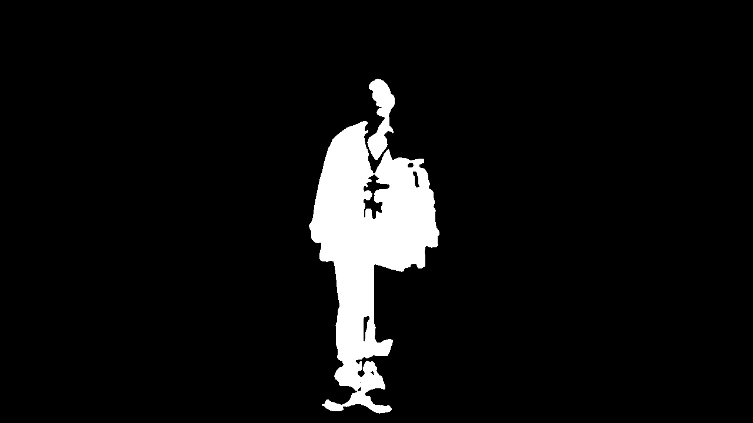
Get Body (Max Connected Components)
Without head
Optimized result

Slide 6
Noise

Slide 7
Say something (Ernest)

Slide 8
TWO
Skeleton

Slide 9
Openpose (Peter)

Slide 10
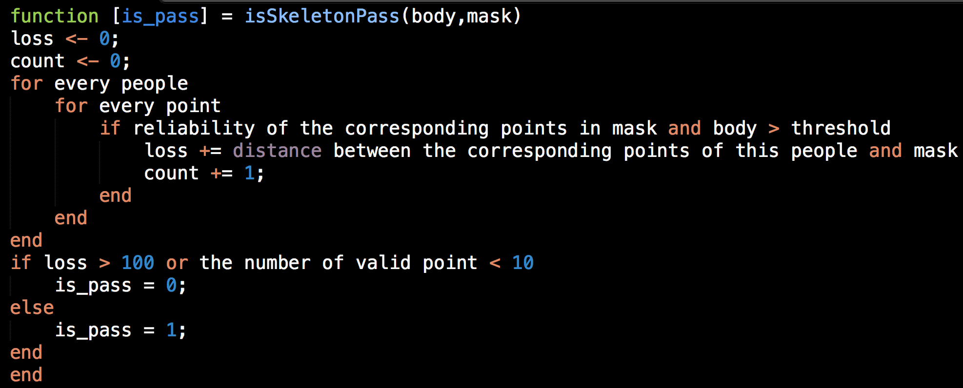
Direct Comparison
Euclidean distance between points in two skeletons

Slide 11
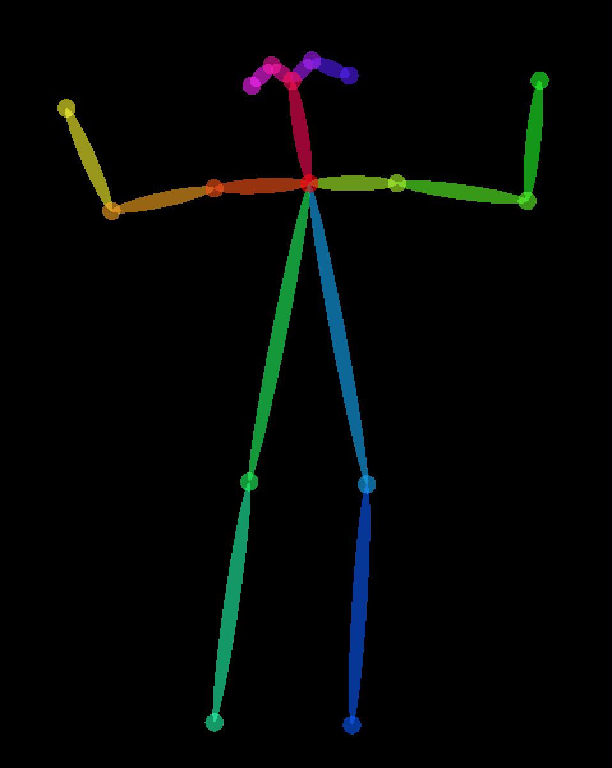
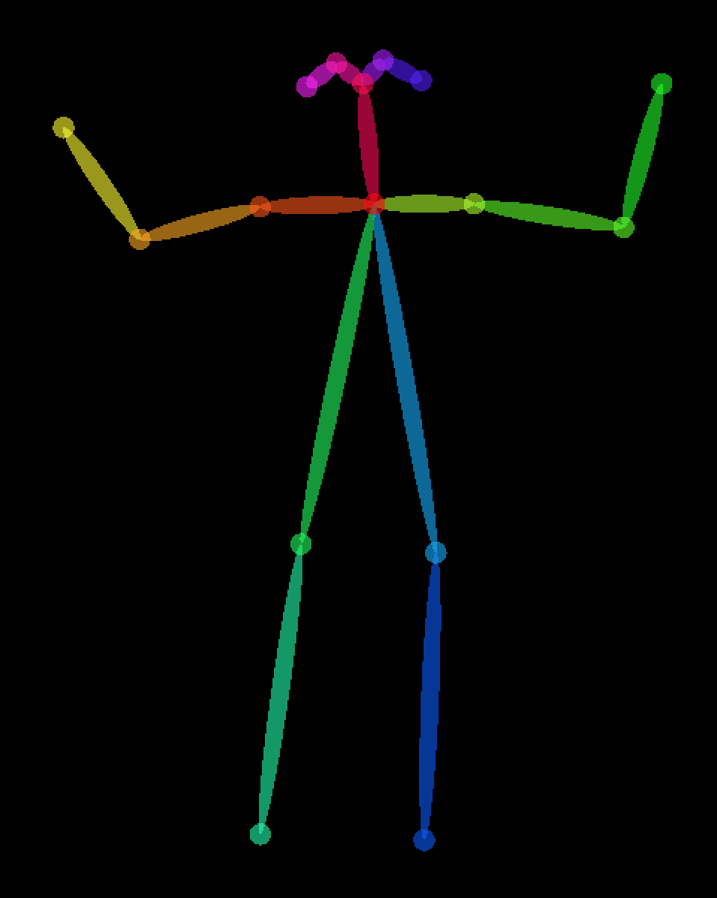
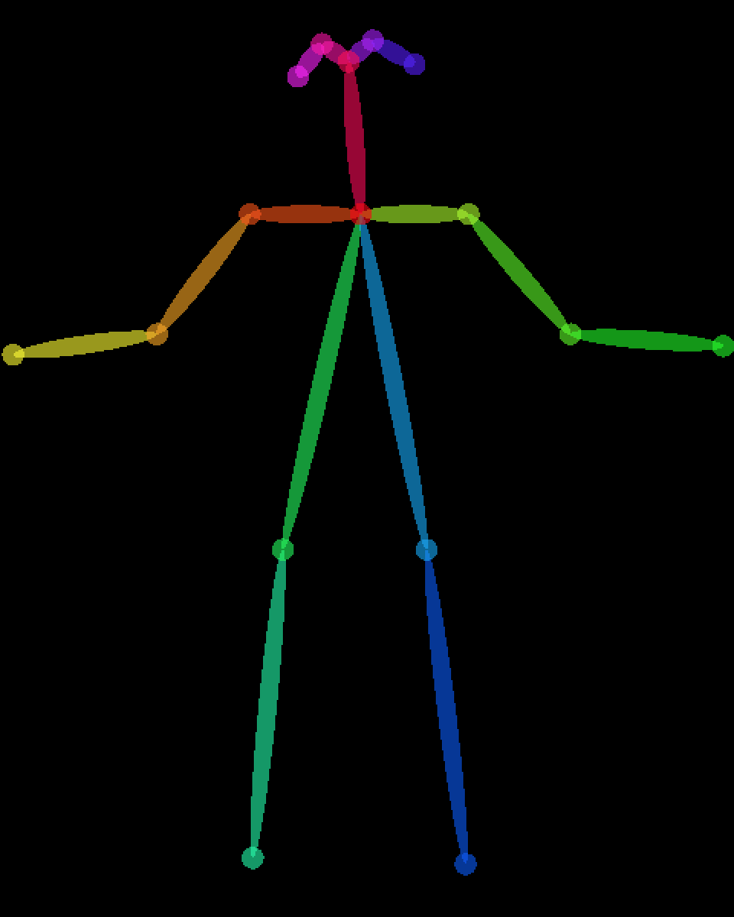
LOSS = 70
Threshold
= 100
V.S.
LOSS = 720

Slide 12
Weighted Comparison
Waiting for Implementation - Peter

Slide 13
TODO
LOSS = 70
Threshold
= 100
V.S.
LOSS = 720

Slide 14
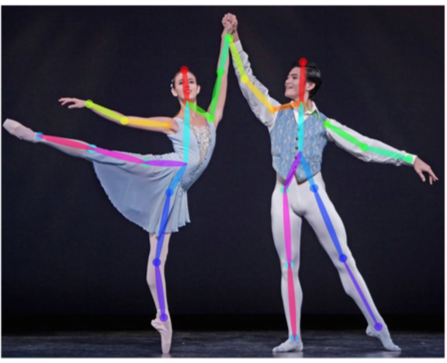
Problem: Passerby
Waiting for our own image

Slide 15
Solution 1: Highest wins
For every people detected by Openpose:
Compute a score
If the highest one passes:
Win
Else:
Fail

Slide 16
Solution 2: Trajectory Prediction
Define the person walking faster as a passerby

Slide 17
THREE
Implementation

Slide 18

PIPELINE
Main
Infinite
loop
Generate
masks
Judge
Naive
Skeleton

Slide 19
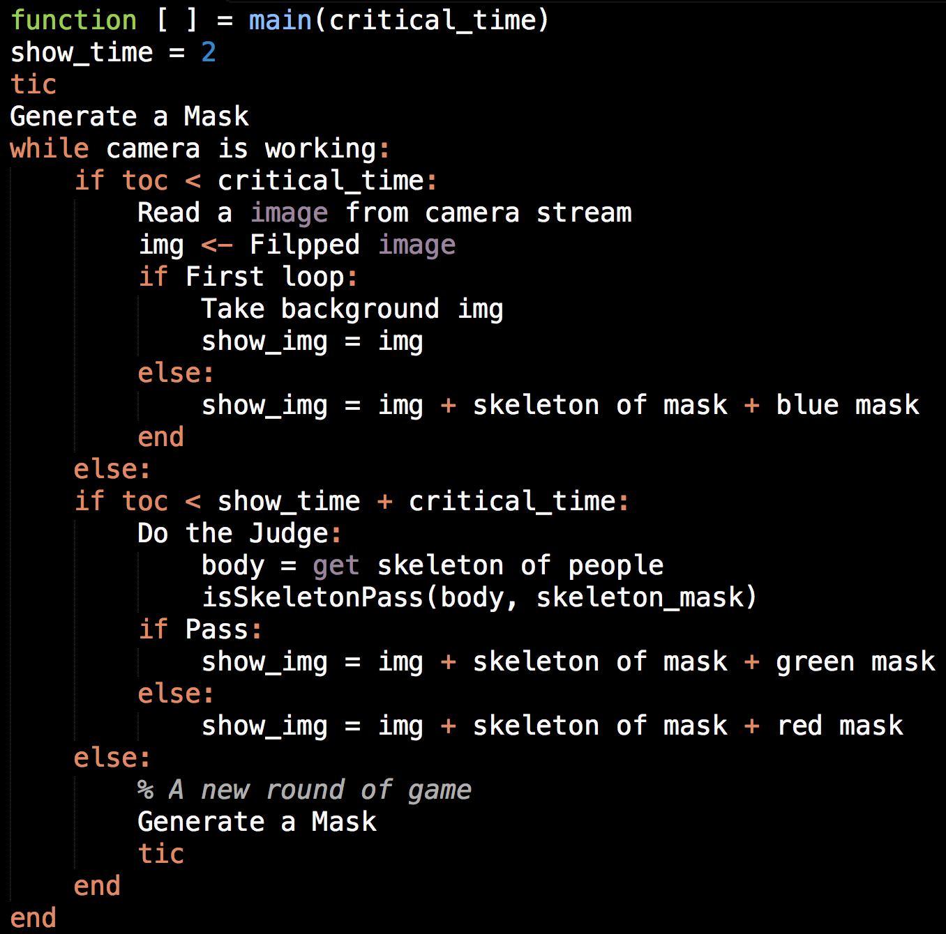
Infinite loop

Slide 20
Taking photos of different poses. (Or from Internet)
Get mask images by body detection.
Randomly choose a mask for a round.
Generate masks

Slide 21
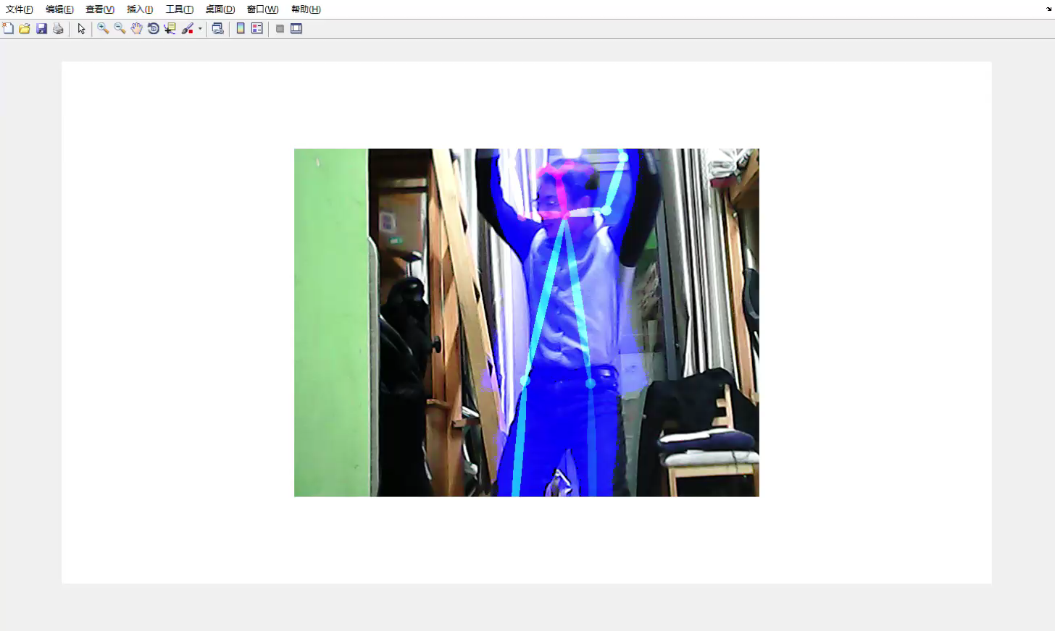
Final Demo

Slide 22


Q&A

